Slide 1
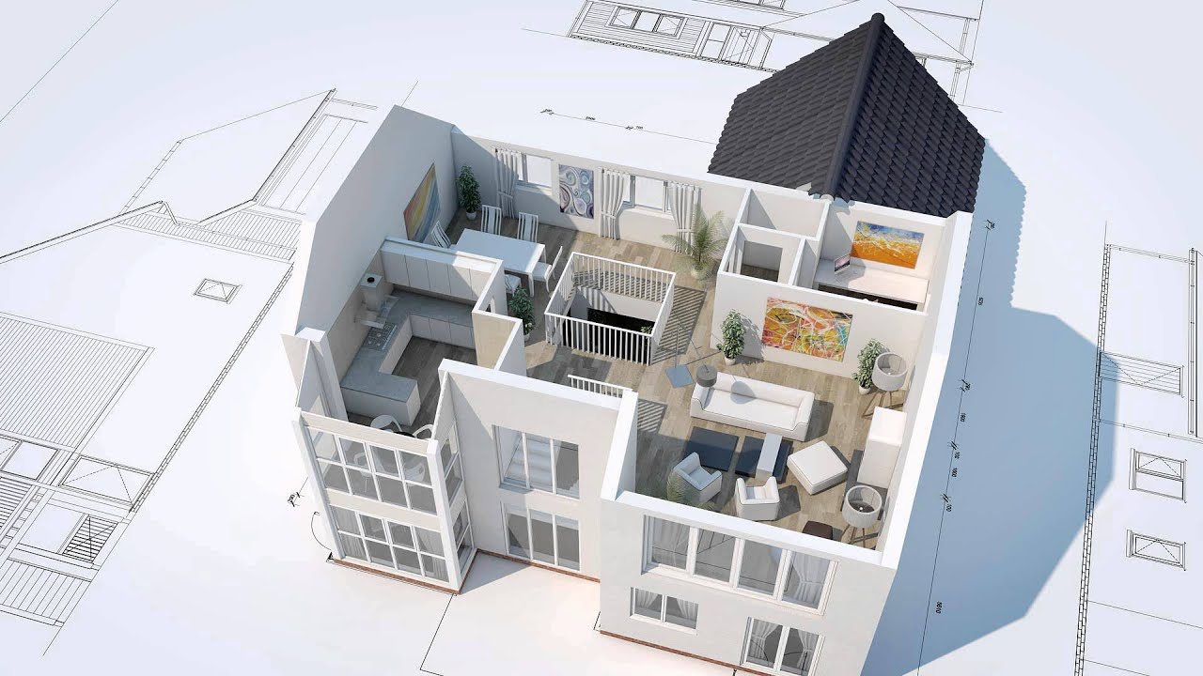
AUTOGENERATION OF 3D MODEL FROM ROOM IMAGES
2016-CE-54
2016-CE-72
2016-CE-81
2016-CS-159

Slide 2
1. INTRODUCTION
Overview
Allow users to import the image of 2D floor plan.
Automatically generate 3D model according to 2D floor plan.
Enables users to change the texture of floor and walls in 3D generated model.
Enables users to add furniture in 3D generated model.
The techniques of image processing and model mapping used to generate the 3D computer graphics model
Have different viewpoints i.e. top-view, walk-through, front-view and side-view of 3D generated model.

Slide 3
1. INTRODUCTION
Background
Why we need to initiate it?
What problems and needs it will address?

Slide 4
1.1 PROBLEM STATEMENT
When anyone plans to construct a new at/house and can only see its floor plan. So it's hard for anyone to imagine the actual environment by just seeing 2-D floor plan. So, our system will enable the users to see this 2-D floor plan into 3-D. Our software helps users to edit 3D model quickly without consuming essential resources i.e. time and money.
.

Slide 5
1.2 MOTIVATION
A common user or an artist who does not know how their home look after construction and proper adjustment of their accessories, it's a big platform for them to see their house in 3D more than their imagination. Already existing such systems can only used by technical users because a lot of manual work is required to construct 3D model from 2D le format. So, this motivates us to automatically generate 3D model from an imported 2D floor plan image by just clicking a button.

Slide 6
2. OBJECTIVES OF PROJECT
Research Objectives
Academic Objectives
Industrial Objectives

Slide 7
3. SCOPE OF THE PROJECT
This project spread towards house planners, architects and common users who want to make their houses according to their own wish. This project handles les of 2D floor plans in image format (.png and .jpeg),then apply image processing techniques on that 2D floor plan to recognize and generate a 3D model accordingly.

Slide 8
11. TARGET AUDIENCE
Common Users
Interior Designers
Architects and Home planners
Real estate sellers agents

Slide 9
5. EXISTING SYSTEM

Slide 10
6. PROPOSED SYSTEM
Our project emphasizes on the generation of 3d models from images of 2D floor plans. The project is somehow unique because it focuses on the making of 3d models by importing images of 2D floor plans which is missing in other softwares. Other softwares main concern is to create 3d model from drawn 2d plan and it will be the innovation in our project.

Slide 11
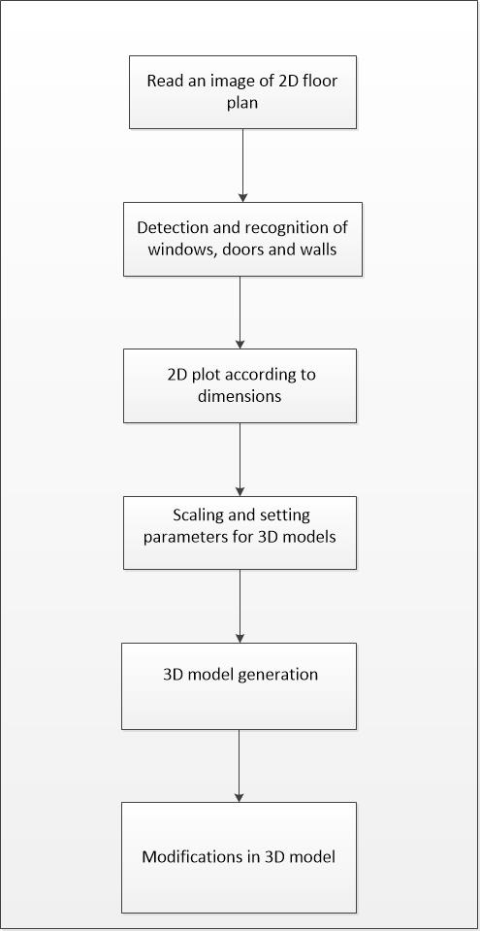
7. METHODOLOGY

Slide 12
4. IDEA COMPLEXITY
h
How our solution is
Different
Efficient
Complex

Slide 13
8. POSSIBLE APPLICATION OF WORK
The architects can use this for 3D visualization of their 2D floor plan.
The interior designers can use this for the purpose of interior designing of 3D generated model.
People who are running real estate businesses can use this for efficient sales promotion.
This software can use in all those areas which require 3D rooms visualization and 3D rooms modification.

Slide 14
10. FEASIBILITY STUDY

Slide 15
9. MARKET SURVEY

Slide 16
12. LIMITATIONS AND CHALLENGES
Selection of Software and 3D graphic tools
Compatibility of other programming language with graphic tools
Image Processing and recognition
No background of computer graphics
Placing texture on 3D model according to position and size

Slide 17


